Slide 1
Week 6: Linked List
WIA1002/ WIB1002/WXES1117 :
Data Structures

Slide 2
Lists
A list is a popular data structure to store data in sequential order. For example, a list of students, a list of available rooms, a list of cities, and a list of books, etc. can be stored using lists. The common operations on a list are usually the following:
Retrieve an element from this list.
Insert a new element to this list.
Delete an element from this list.
Find how many elements are in this list.
Find if an element is in this list.
Find if this list is empty.

Slide 3
Linked Lists
Since MyArrayList is implemented using an array, the methods get(int index) and set(int index, Object o) for accessing and modifying an element through an index and the add(Object o) for adding an element at the end of the list are efficient. However, the methods add(int index, Object o) and remove(int index) are inefficient because it requires shifting potentially a large number of elements. You can use a linked structure to implement a list to improve efficiency for adding and removing an element anywhere in a list.

Slide 4

Introducing Linked Lists
Think of each element in a linked list as being an individual piece in a child's pop chain. To form a chain, insert the connector into the back of the next piece

Slide 5
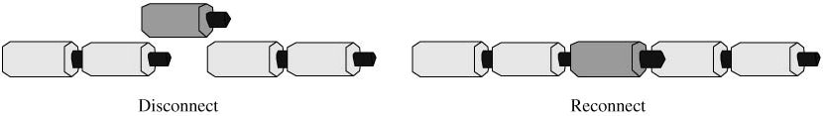
Introducing Linked Lists
Inserting a new piece into the chain involves merely breaking a connection and reconnecting the chain at both ends of the new piece.

Slide 6
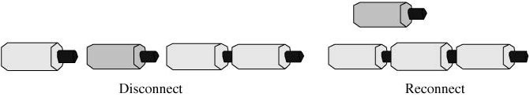
Introducing Linked Lists
Removal of a piece from anywhere in the chain requires breaking its two connections, removing the piece, and then reconnecting the chain.

Slide 7
Introducing Linked Lists
Inserting and deleting an element is a local operation and requires updating only the links adjacent to the element. The other elements in the list are not affected. An ArrayList must shift all elements on the tail whenever a new element enters or exits the list.

Slide 8
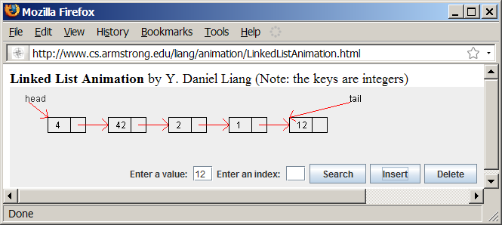
Linked List Animation
www.cs.armstrong.edu/liang/animation/LinkedListAnimation.html

Slide 9
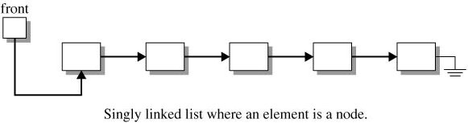
Structure of a Linked List (concluded)
A singly-linked list is not a direct access structure. It must be accessed sequentially by moving forward one node at a time

Slide 10
Nodes in Linked Lists
A linked list consists of nodes.
Each node contains an element, and a reference linked to its next neighbor. The first variable, element, is of generic type T. The second variable is a Node reference called next that provides a link to the next node.
A node with its two fields can reside anywhere in memory.

Slide 11
Creating a Linked List
Linked lists are implementation structures and so Node objects are rarely visible in the public interface of a data structure. As a result, we declare the instance variables in the Node class public. This greatly simplifies the writing of code involving linked lists.
The Node class is a self‑referencing structure, in which the instance variable, next, refers to an object of its own type.

Slide 12
The Node Class
public class Node<E> {
E element;
Node<E> next;
public Node() { //default constructor
element = null; //with no initial value
next = null;
}
public Node(E item) {
element = item; //initialize element to item
next = null; //set next to null
}
}

Slide 13
Check Point
How to create an object(eg: String) for class Node?

Slide 14
Adding Three Nodes
The variable head refers to the first node in the list, and the variable tail refers to the last node in the list. If the list is empty, both are null. For example, you can create three nodes to store three strings in a list, as follows:
Step 1: Declare head and tail:

Slide 15
Adding Three Nodes, cont.
Step 2: Create the first node and insert it to the list:

Slide 16
Adding Three Nodes, cont.
Step 3: Create the second node and insert it to the
list:

Slide 17
Adding Three Nodes, cont.
Step 4: Create the third node and insert it to the
list:

Slide 18
Traversing All Elements in the List
Each node contains the element and a data field named next that points to the next element.
If the node is the last in the list, its pointer data field next contains the value null.
You can use this property to detect the last node. For example, you may write the following loop to traverse all the nodes in the list.
Node<E> current = head;
while (current.next != null) {
System.out.println(current.element);
current = current.next;
}

Slide 19
MyLinkedList
MyLinkedList
TestMyLinkedList
Run

Slide 20
Implementing addFirst(E o)
1 public void addFirst(E o) {
2 Node<E> newNode = new Node<E>(o);
3 newNode.next = head;
4 head = newNode;
5 size++;
6
7 if (tail == null)
8 tail = head;
9 }

Slide 21
Implementing addFirst(E o)

Slide 22
Implementing addLast(E o)
1 public void addLast(E o) {
2 if (tail == null) {
3 head = tail = new Node<E>(element);
4 }
5 else {
6 tail.next = new Node(element);
7 tail = tail.next;
8 }
9 size++;
10 }

Slide 23
Implementing addLast(E o)

Slide 24
Implementing add(int index, E o)
1 public void add(int index, E o) {
2 if (index == 0) addFirst(o);
3 else if (index >= size) addLast(o);
4 else {
5 Node<E> current = head;
6 for (int i = 1; i < index; i++)
7 current = current.next;
8 Node<E> temp = current.next;
9 current.next = new Node<E>(o);
10 (current.next).next = temp;
11 size++;
12 }
13 }

Slide 25
Implementing removeFirst()
public E removeFirst() {
if (size == 0) return null;
else {
Node<E> temp = head;
head = head.next;
size--;
if (head == null) tail = null;
return temp.element;
}
}

Slide 26
Implementing removeLast()
public E removeLast() {
if (size == 0) return null;
else if (size == 1)
{
Node<E> temp = head;
head = tail = null;
size = 0;
return temp.element;
}
else
{
Node<E> current = head;
for (int i = 0; i < size - 2; i++)
current = current.next;
Node<E> temp = tail;
tail = current;
tail.next = null;
size--;
return temp.element;
}
}

Slide 27
Implementing remove(int index)
public E remove(int index) {
if (index < 0 || index >= size) return null;
else if (index == 0) return removeFirst();
else if (index == size - 1) return removeLast();
else {
Node<E> previous = head;
for (int i = 1; i < index; i++) {
previous = previous.next;
}
Node<E> current = previous.next;
previous.next = current.next;
size--;
return current.element;
}
}

